Slide 1

Birdsong Paradise
Pop Music Analysis

Slide 2
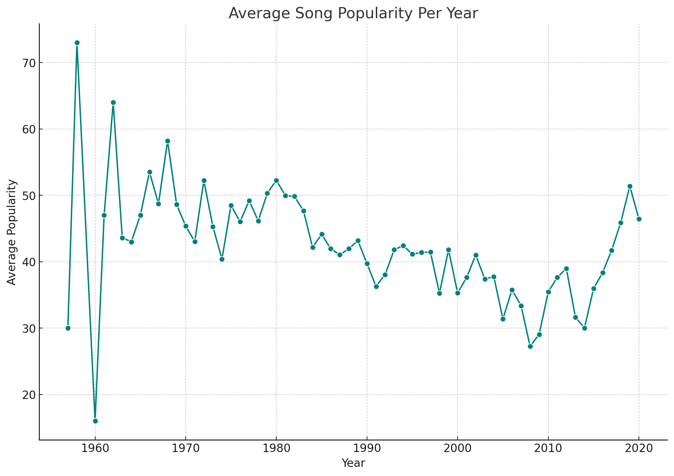
Evolving Tastes: The Rise of Song Popularity Over Years
Key Insights:
• Upward trend in song popularity since 2018. • Digital platforms may influence music consumption behaviors.

Slide 3
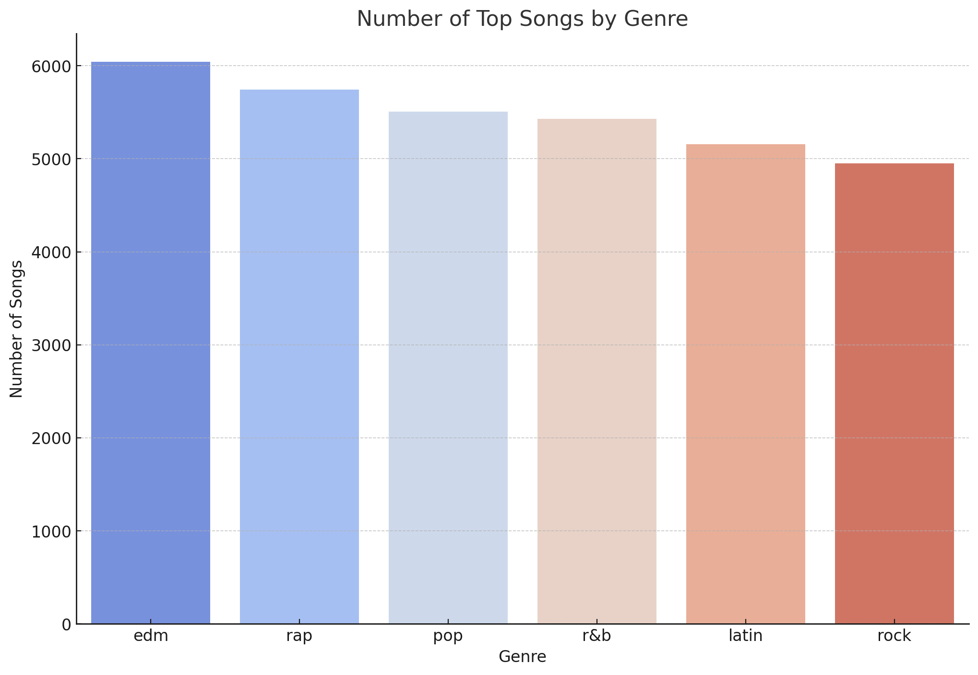
Genre Dynamics: Pop and Dance Pave the Chart's Top
Key Insights:
• Pop and dance genres lead in popularity, reflecting their widespread appeal. • Hip-hop's smaller representation suggests niche preferences.

Slide 4
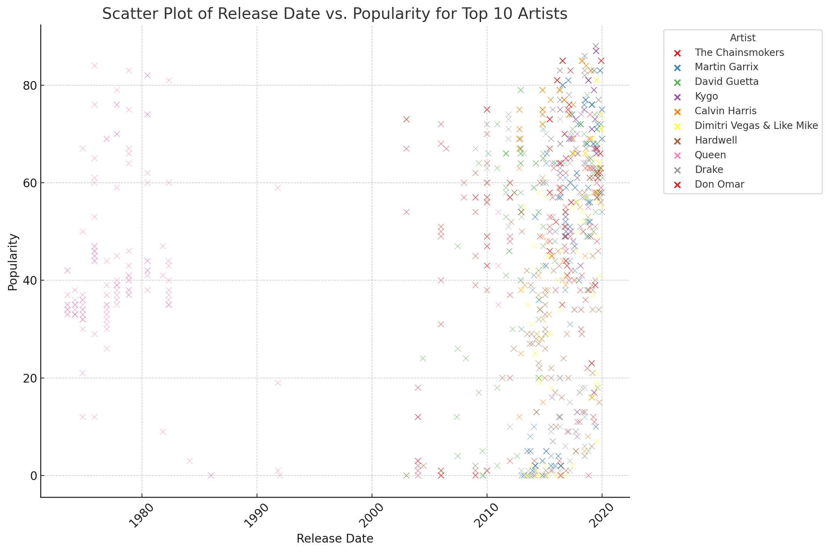
Influence & Popularity: Insights from the Top 10 Artists
Key Insights:
• Top artists exhibit varied popularity trends, showing diverse audience reach. • Consistent high performers hint at strong production and marketing.

